Slide 1
Home
Special
Order
Account
Comment
CHOC O LAT

Slide 2


ADD

Slide 3
Quickly access to your account
Name
Surname
Email
Choice
Submit

Slide 4

Discount code:
Apply discount code
Your Order is on
Your Order is on

Slide 5


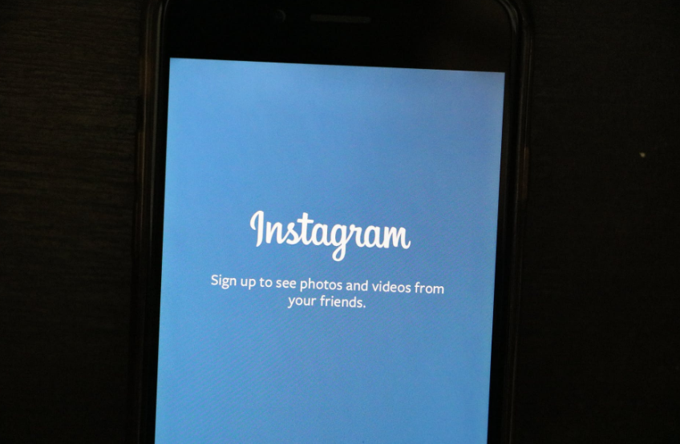


Email: cholatetaste@gmail.com
Address:Ashton Underlyne M11 27W
Telephone: 07451864828

